Slide 1
Competing at UKIFAC

Slide 2
Contents
About UKIFAC
General information
Registration and Bow-check
IFAA Rounds
On the range
Other

Slide 3
About UKIFAC
UKIFAC OVERVIEW
TIMETABLE
UKIFAC is an annual, two day competition comprising of a 1x28 IFAA FIELD and a 1x28 HUNTER round
3 x 14 target courses are also permissible
UKIFAC is generally held the first weekend in July
The tournament is open to all members of EFAA, IFAF, NIFAA, SFAA and WFAA.
Members of IFAA affiliate nations may compete as ‘guests’ at the discretion of the host nation
FRIDAY
Registration & Bow-check open
Practice Range open
SATURDAY
Registration & Bow-check open
Practice Range open
Safety briefing
Day 1 of the competition
SUNDAY
Practice Range open
Safety briefing
Day 2 of the competition
Awards Ceremony

Slide 4
General Information
COMPETITOR PREREQUISITS
TRAVEL ESSENTIALS
IFAA affiliation
Is your IFAF membership paid-up?
Do you have a Classification Card?
The Card should have at least TWO scores for Field &/or Hunter rounds
Classification scores are valid for two years
For styles requiring classifications, archers who do not have a valid classification are deemed ‘Unclassified’ meaning they default into A class for the competition.
Passport / National ID Card
Is your travel document in date?
E111 Card & Travel Insurance
Apply for an E111 card online
Purchase travel insurance
Flight vs. Ferry
Accommodation booked
Car hire vs. Public transport
Do you have a FULL driving licence?
Is there transport to the shoot site?

Slide 5
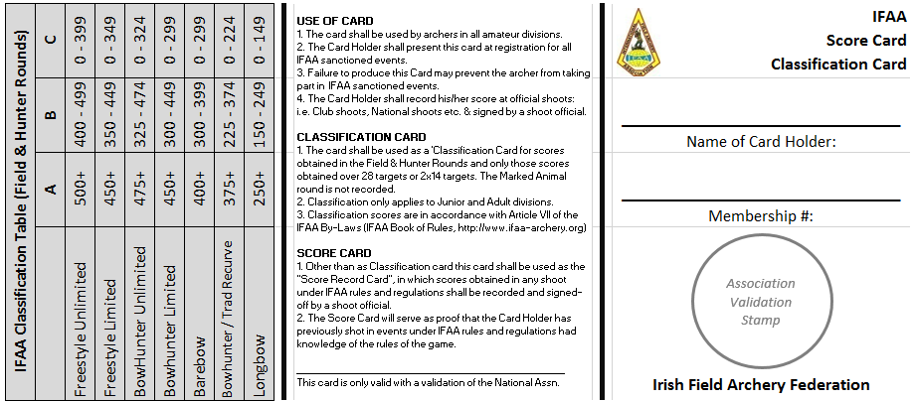
Registration & Bow-check
PAPERWORK TO PRESENT
EQUIPMENT TO PRESENT
Documents
IFAF Membership card
Classification-Scorecard
Bow
Compounds will be speed-checked
Marks considered sighting aids will be covered by the bow checkers
Arrows
Arrows must be numbered 1, 2, 3 & 4 using rings near to the fletches
Tabs
No marks to aid shooting allowed
Binoculars
Only binoculars with a bow-check sticker can be used on the range

Slide 6
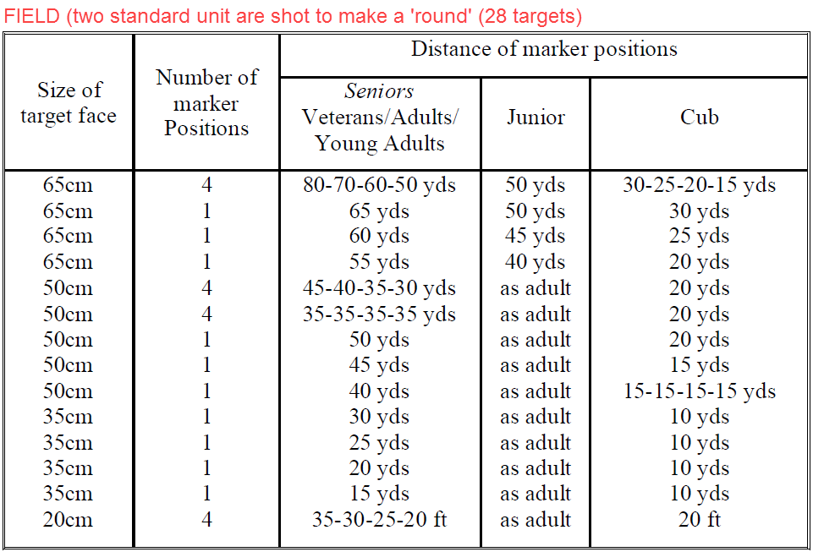
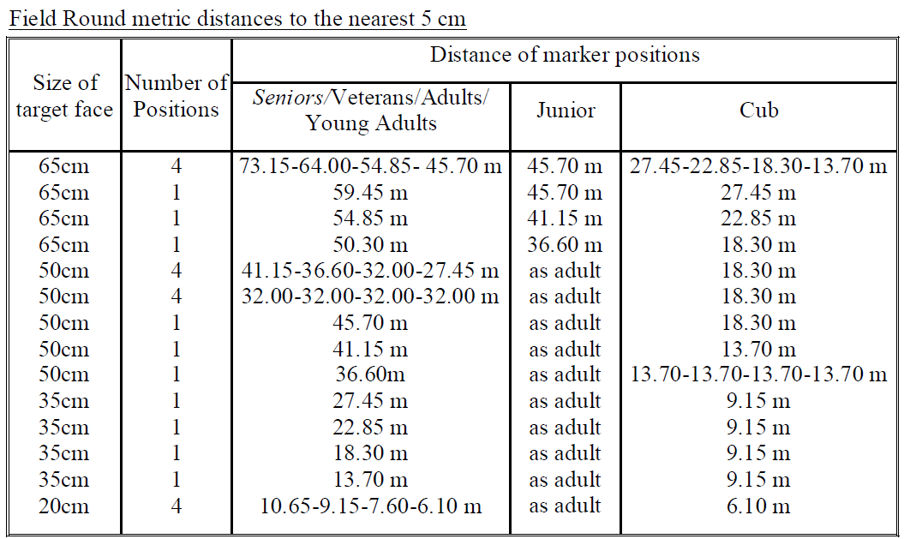
IFAA Rounds
FIELD

Slide 7
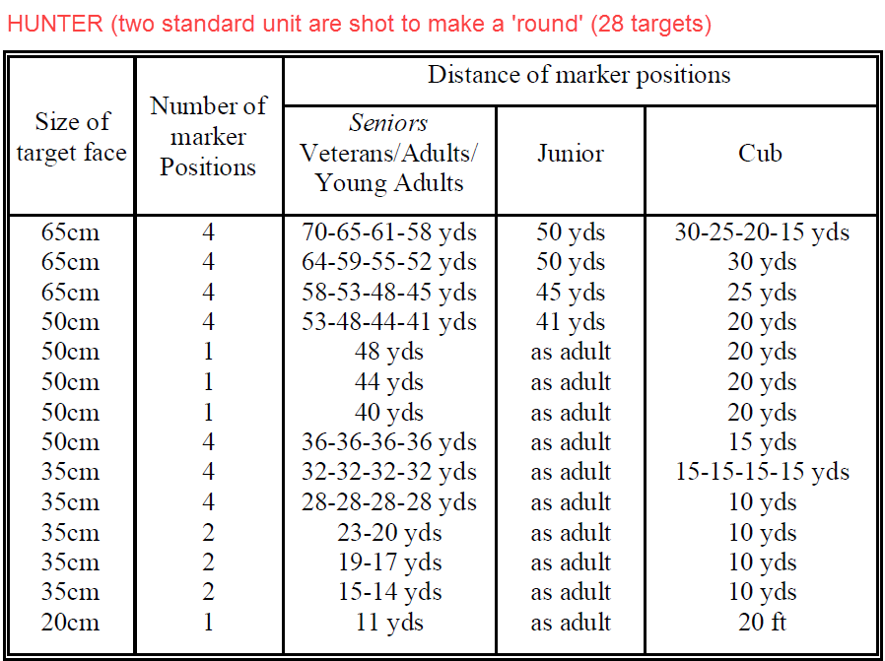
IFAA Rounds
HUNTER

Slide 8
On the Range
WHAT TO BRING
Scorecards
Bring the correct scorecard for the round being shot
Equipment
Bow, arrows, quiver, binoculars
Essentials
Clothing for all seasons, hat, seat, sun cream, bug-spray!
Money
Lunch is usually a ‘rolling stop’. Food/drink can be purchased at catering, if offered at the venue
Refreshments
Bring a bag with food and drink in it… you may be hungry/thirsty before you reach catering.
Smoking
Smoking, including E-Cigarettes, is normally NOT ALLOWED on the course, only at designated food stops

Slide 9
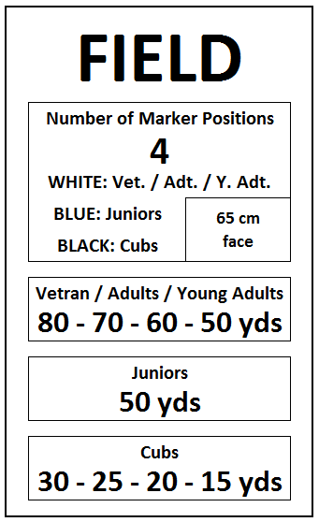
On the Range
RULES and ETIQUETTE
Group position/role assigned
The ordering of names in the group determines role (cannot be changed)
#1: Target Captain
#2: First Scorer
#3: Second Scorer
#4: Arrow Puller
#5 (or greater): No role assigned. General etiquette is to look for arrows
Target Captain’s job
monitor shooting rotation
settle all local questions
decide on arrow scores except their own, this is done by the First Scorer
Targets
At each target there will be a notice board about the target:

Slide 10
On the Range
RULES and ETIQUETTE
Shooting
Archers must SHOOT IN PAIRS
A/B: Target Captain / First Scorer
C/D: Second Scorer / Arrow Puller
E/F: Arrow finders
Archers must ROTATE SHOOTING ORDER
Target 1 – 14: A/B pair then C/D pair
Target 15 – 28: C/D pair then A/B pair
Archers must ROTATE SHOOTING POSITION
Target 1 – 14: Left: A (C) / Right: B (D)
Target 15 – 28: Left: D (B) / Right: C (A)
Unclear/unsafe shot rule: You are entitled to shoot a target singly if you feel you do not have a clear shot of the target or your footing is not sound.
Foot placement rule (double marker): One foot shall touch or not be more than six inches behind or to either side of a marker.
Arrows can be shot in any order except for the 20 cm face. The ‘bunny’ must be shot in a ‘Z-formation’ starting top left (arrow #1) and finishing bottom right (arrow #4).

Slide 11
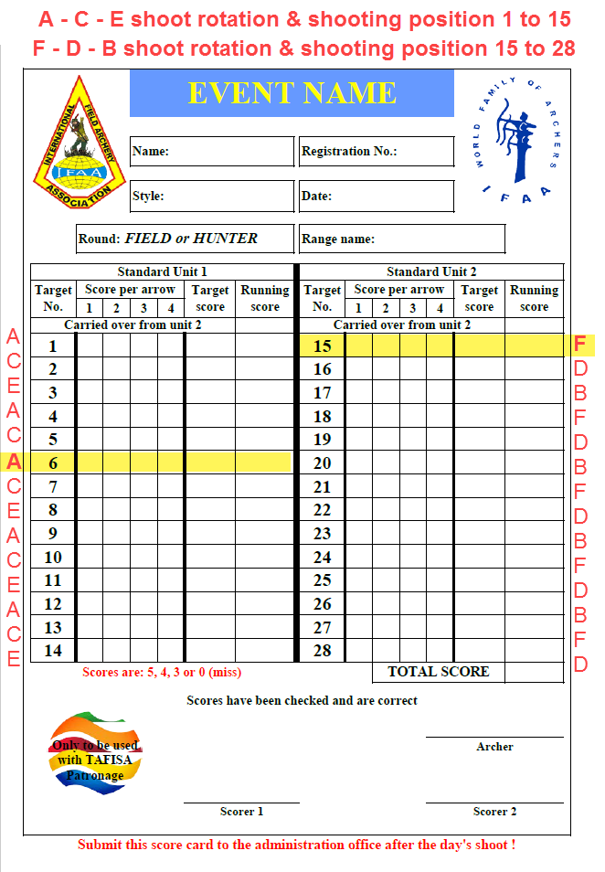
On the Range
RULES and ETIQUETTE
Scoring
Marking scorecards with A-C-E / F-D-B, as shown, helps track shoot rotation
Arrows MUST arrow must cut through the line to score the higher value
DO NOT touch arrows in the target, to do so will forfeit your score
DO NOT pull arrows until scoring completed
DO pay attention to the score being called for you. It is hard to correct mistakes later
DO check your final scores match. It is hard to later correct results entered for you

Slide 12
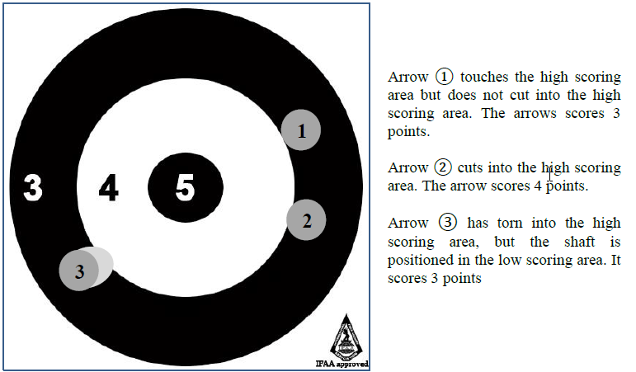
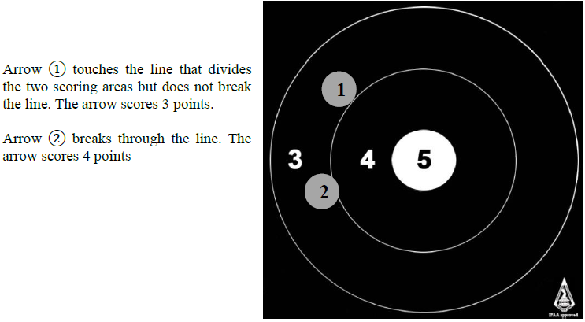
On the Range
SCORING

Slide 13
On the Range
Shooting Groups
Adults
Groups shall consist of no less than 3 and up to 6 adult archers.
Cubs
Unless cub minders are provided cubs shall shoot with a parent or a shooting “guardian” who shall be agreed before shooting commences.
Groups must consist of at least 3 adult archers plus the cub/cubs.
Groups will be decided on the style of the parent or guardian not the cub. Cubs may not therefore be shooting head to head.
Cubs do not count as scorers in a group.
Multiple cub entries from one family will be split between the parents if possible
Juniors
Groups shall consist of no less than 3 and up to 6 junior archers.
If there are not enough juniors to make a group of any combination of styles they must be grouped with a parent or shooting “guardian” who shall be agreed before shooting commences

Slide 14
Other
TEAM OF NATIONS
SUBMITTING A PROTEST
Team structure
x1 AMFU or AFFU
x1 AMBU or AFBU
x1 AMFS or AFFS (Recurve or Comp.)
x1 AMBB or AFBB (Recurve or Comp.)
x1 AMBH or AFBH (Recurve or Comp.)
x1 AMLB or AFLB
Note: Where there are insufficient numbers to fill all styles archers can move-up a style (BHR to BB) but not down (FU to BU)
Protest Committee
A Protest Committee will consider and rule on all disputes and protests submitted at the tournament.
Protests must be submitted in writing, along with the appropriate fee as decided by the host, no later than one-hour after completion of that day's shooting
The Protest Committee shall only consider protests in relation to the Rules of Shooting. All other matters will be referred to the tournament host.
Where the protest is upheld the protest fee shall be returned to the individual making the protest, if the protest is not upheld the fee shall be forfeit and shall go to the host nation of the tournament.
No person may submit a protest on behalf of another person.
No cub may submit a protest.
UKIFAC ROTATION

