Slide 1
Competing at UKIFAC
Updated 2022

Slide 2
Contents
About UKIFAC
General information
Registration and Bow-check
IFAA Rounds
On the range
Other

Slide 3
About UKIFAC
UKIFAC OVERVIEW
TIMETABLE
UKIFAC is an annual, two day competition comprising of a 1x28 IFAA FIELD and a 1x28 HUNTER round
2 x 14 target courses permissible (2 units give the 28 targets). Additional 14s added to accommodate increasing participation numbers, as required
Hosts specify the date of their event at the current years' event. If no date is announced, UKIFAC will default to the second weekend in July
The tournament is open to all members of EFAA, IFAF, NIFAA, SFAA and WFAA.
Members of IFAA affiliate nations may compete as ‘guests’ at the discretion of the host nation
FRIDAY
Registration & Bow-check open
Practice Range open
SATURDAY
Registration & Bow-check open
Practice Range open
Safety briefing
Day 1 of the competition
SUNDAY
Practice Range open
Safety briefing
Day 2 of the competition
Awards Ceremony

Slide 4
General Information
COMPETITOR PREREQUISITS
TRAVEL ESSENTIALS
IFAA affiliation
Is your IFAF membership paid-up?
Do you have a Classification Card?
Every archer, including those whose category does not have Classifications, must have at least TWO scores for Field &/or Hunter rounds to demonstrate experience of the rounds
For styles with Classifications (A, B or C), scores are valid for two years
For styles requiring classifications, archers without a valid classification are deemed ‘Unclassified’ meaning they default into A class.
Passport / National ID Card
Is your travel document in date?
E111 Card & Travel Insurance
Apply for an E111 card online
Purchase travel insurance
Flight vs. Ferry logistics comparison
Accommodation booked
Car hire vs. Public transport
Do you have a FULL driving licence?
Is there transport to the shoot site?

Slide 5
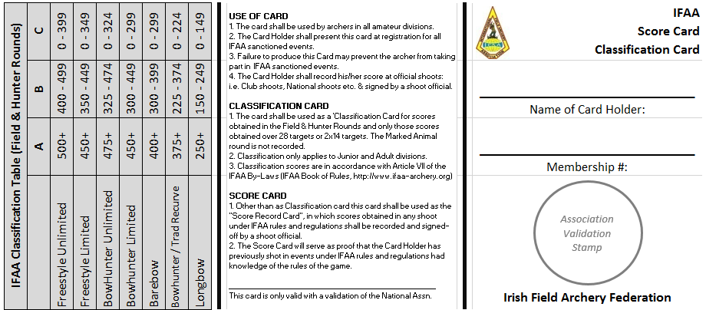
Registration & Bow-check
PAPERWORK TO PRESENT
EQUIPMENT TO PRESENT
Documents
IFAF Membership card
Classification-Scorecard
IFAF’s Classification cards are issued by the International Rep (internatonal@ifaf.ie)
Bow
Compounds will be speed-checked
Marks considered sighting aids will be covered by the bow checkers
Bows / bow-styles must comply with IFAA rules (e.g. IFAF Trad will not be recognised, this category will be converted to IFAA Trad)
Arrows
Arrows must be numbered 1, 2, 3 & 4 using rings near to the fletches (IFAF Handbook / Rule)
Tabs
No marks to aid shooting allowed
Binoculars
Binoculars do not need to be inspected. They can have range-finding functions because rounds are marked-distance

Slide 6
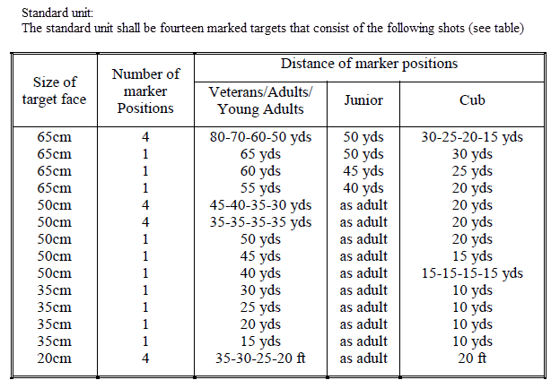
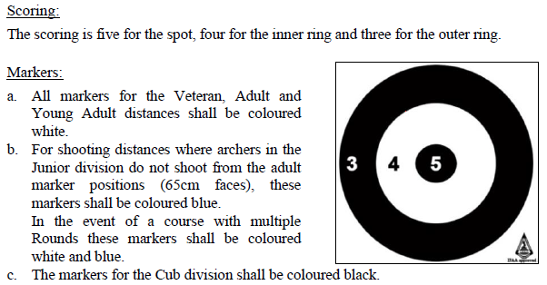
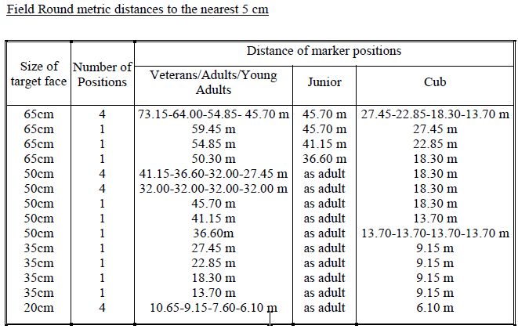
IFAA Rounds: Field

Slide 7
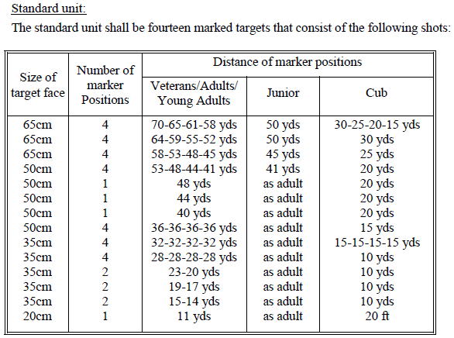
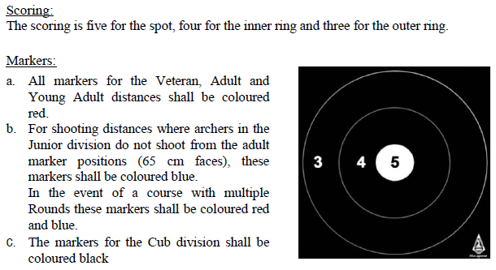
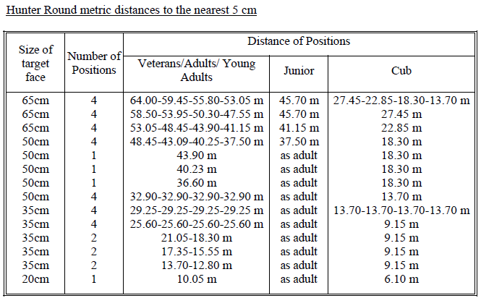
IFAA Rounds: Hunter

Slide 8
On the Range
WHAT TO BRING
Scorecards
Bring the correct scorecard for the round being shot
Equipment
Bow, arrows, quiver, binoculars
Essentials
Clothing for all seasons, hat, portable seat, sun cream, bug-spray!
Money
Lunch is usually a ‘rolling stop’. Food/drink can be purchased at catering, if offered at the venue
Refreshments
Bring a bag with food and drink in it… you may be hungry/thirsty before you reach catering.
Smoking
Smoking, including E-Cigarettes, is normally NOT ALLOWED on the course, only at designated food stops

Slide 9
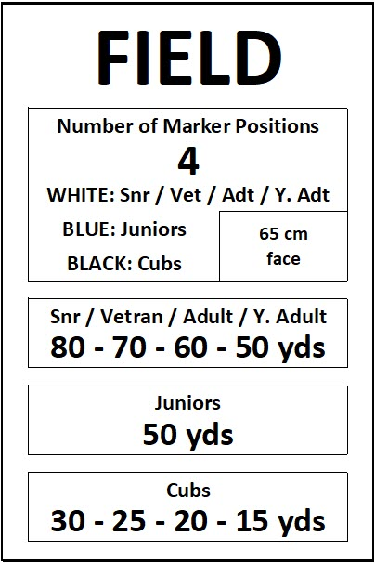
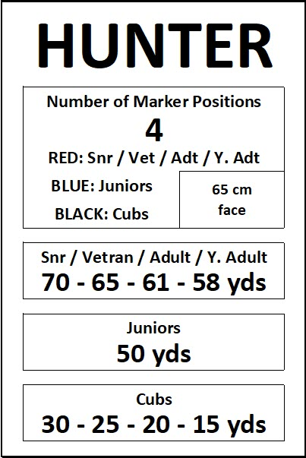
On the Range
Scoring disputes
In the case of a dispute, the majority opinion of the other archers in the group decides on the score. Period.
Pegs
All adults: Field – White, Hunter - Red
Juniors: Field & Hunter – Blue
Cubs: Field & Hunter – Black
Targets
At each target a notice board will provide details about the target:
RULES and ETIQUETTE
Group position/role assigned
The ordering of names in the group determines role (cannot be changed)
#1: Target Captain
#2: First Scorer
#3: Second Scorer
#4: Arrow Puller
Target Captain’s job
monitor shooting rotation
settle all local questions
manage back-logs/shoot throughs

Slide 10
On the Range
Unclear/unsafe shot rule
You are entitled to shoot a target singly if you feel you do not have a clear shot of the target or your footing is not sound.
Foot placement rule
(1) Single marker lay-out: No archer shall shoot from in front of the appropriate marker. One foot shall not be more than six inches behind or a maximum of three feet to either side of such marker. For all Animal rounds, marked or unmarked, there shall be two markers.
(2) Double marker lay-out: No archer shall shoot from in front of the appropriate marker. One foot shall touch or not be more than six inches behind or to either side of such marker.
Sequence of arrows shot rule
Arrows can be shot in any order except for the 20 cm ‘bunny’ face.
The ‘bunny’ must be shot in a ‘Z-formation’ starting top left (arrow #1) and finishing bottom right (arrow #4).
RULES and ETIQUETTE
Shooting
Archers MUST shoot in pairs
A/B: Target Captain / First Scorer
C/D: Second Scorer / Arrow Puller
Archers MUST rotate shoot order
Target 1 – 14: A/B pair then C/D pair
Target 15 – 28: C/D pair then A/B pair
Archers MUST rotate shoot position
Target 1 – 14: Left: A (C) / Right: B (D)
Target 15 – 28: Left: D (B) / Right: C (A)

Slide 11
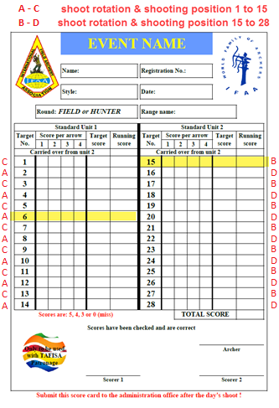
On the Range
RULES and ETIQUETTE
Scoring
Marking scorecards with A-C / B-D, as shown, helps track shoot rotation
Rotation is by ‘unit’. Best practice is to start rotation on the starting target (e.g. #6) and continue A-C rotation until end of Unit 1 then switch to B-D rotation for all of Unit 2 (e.g. #15)
Arrows MUST arrow must cut through the line to score the higher value
DO NOT touch arrows in the target, to do so will forfeit your score
DO NOT pull arrows until scoring completed
DO pay attention to the score being called for you. It is hard to correct mistakes later
DO check your final scores match. It is much harder to later change results entered for you/signed-off by you

Slide 12
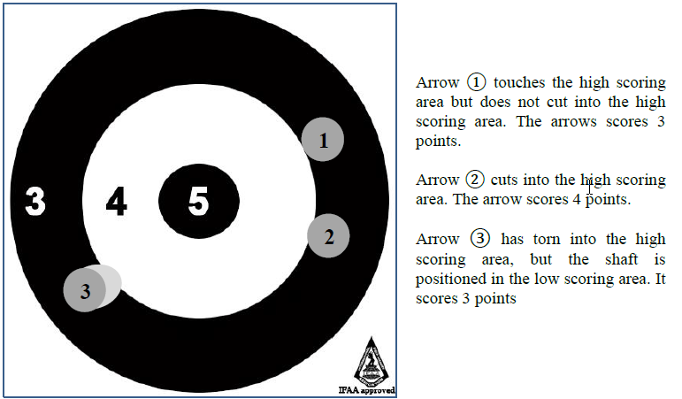
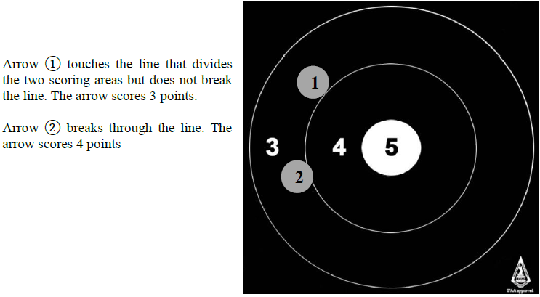
On the Range
SCORING

Slide 13
On the Range
Shooting Groups
Adults
Groups shall consist of no less than 3 and up to 6 adult archers.
Cubs
Unless cub minders are provided cubs shall shoot with a parent or a shooting “guardian” who shall be agreed before shooting commences.
Groups must consist of at least 3 adult archers plus the cub/cubs.
Groups will be decided on the style of the parent or guardian not the cub. Cubs, therefore, may not be shooting head to head.
Cubs do not count as scorers in a group.
Multiple cub entries from one family will be split between the parents if possible
Juniors
Groups shall consist of no less than 3 and up to 6 junior archers.
If there are not enough juniors to make a group of any combination of styles they must be grouped with a parent or shooting “guardian” who shall be agreed before shooting commences

Slide 14
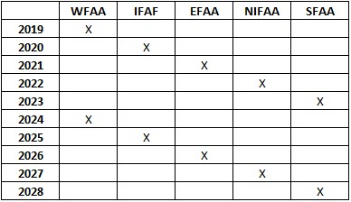
Other
TEAM OF NATIONS
SUBMITTING A PROTEST
Team structure
x1 AMFU or AFFU
x1 AMBU or AFBU
x1 AMFS or AFFS (Recurve or Comp.)
x1 AMBB or AFBB (Recurve or Comp.)
x1 AMBH or AFBH (Recurve or Comp.)
x1 AMLB or AFLB
Note: Where there are insufficient numbers to fill all styles archers can move-up a style (BHR to BB) but not down (FU to BU)
Protest Committee
A Protest Committee will consider and rule on all disputes and protests submitted at the tournament.
Protests must be submitted in writing, along with the appropriate fee as decided by the host, no later than one-hour after completion of that day's shooting
The Protest Committee shall only consider protests in relation to the Rules of Shooting. All other matters will be referred to the tournament host.
Where the protest is upheld the protest fee shall be returned to the individual making the protest, if the protest is not upheld the fee shall be forfeit and shall go to the host nation of the tournament.
No person may submit a protest on behalf of another person.
No cub may submit a protest.
UKIFAC ROTATION

